Slide 1
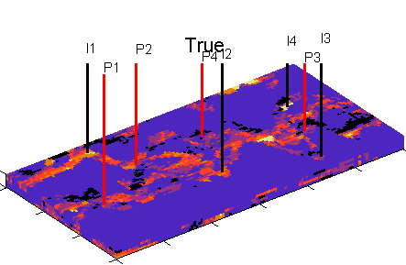
Structural and Shape Reconstruction using Inverse Problems and Machine Learning Techniques with Application to Hydrocarbon Reservoirs
PhD Viva
PhD Candidate: Clement Oku Etienam
Internal Examiner: Dr Nan Zhang
External Examiner: Dr Piroska Lorinczi

Slide 2
Introduction
Talk Overview
Background Knowledge
History Matching with Level set
Electromagnetic History Matching
4D Seismic History Matching
History Matching with Machine Learning
Conclusion
References

Slide 3
Background Knowledge

Slide 4
Background
History matching
Inverse Problem: given specific observations (i.e.: real pressure & production data), infer information about model parameters (porosity & permeability).
The number of observations are finite and the data always contains measurement errors.
Constraining the outputs from a reservoir simulator (i.e.: simulated pressure & production data) by changing the uncertain model parameters to mimic the observations is known as History matching.
Maintain geological realism.
Be conceptually understandable to the user and management given a reasonable amount of training.
Have predictive power not just in terms of matching future field production but in terms of the physics of the system.

Slide 5
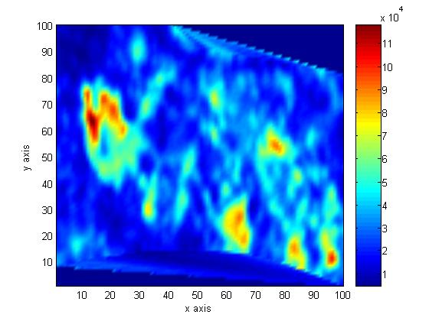
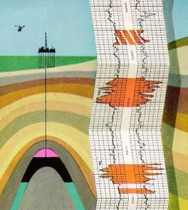
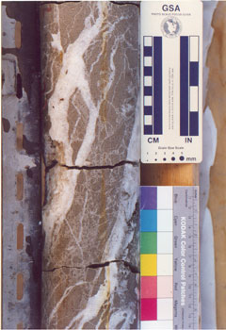
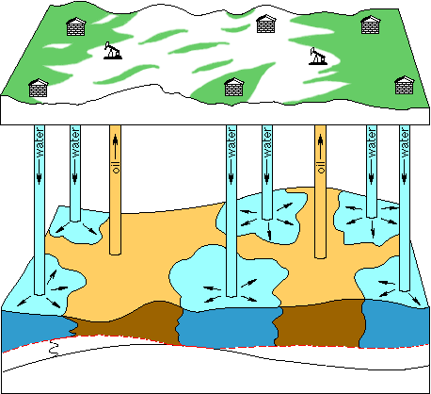
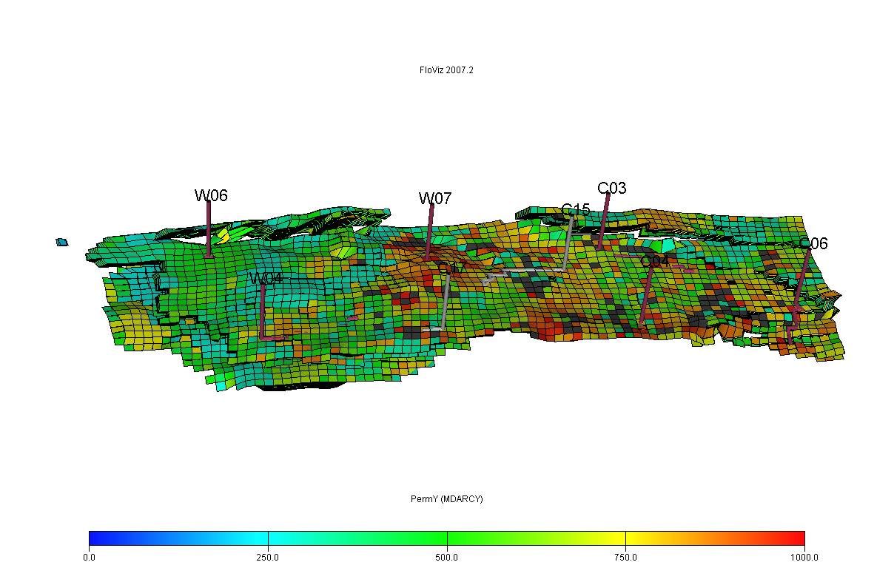
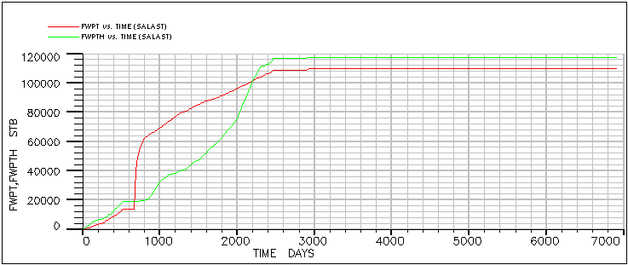
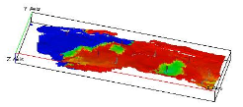
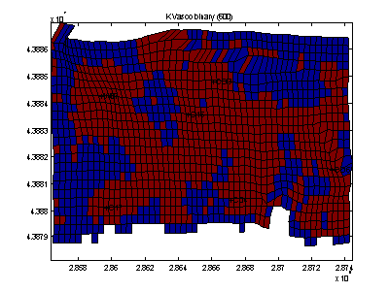
Workflow: Introduction
PRIOR. DATA (well logs, core analysis, petrophysics, PVT...)
low frequency EM (ΔH):
+
+
ΔA=f(ΔP, ΔSw, …)
SATURATION INVERSION
(Δσ = g(ΔSw,..))
K (mD) from 4D seismic
Geomechanics, Faults,
CO2 Capture & Storage
4D seismic (ΔA)
NEW 3D Property map
INVERSE PROBLEM
Geostatistics
MPS
SHAPE Evolution
Fluid flow eq.
HISTORY MATCHING
PRODUCTION DATA
COST FUNCTION
- Adjoint Technique
- EnKF & ES
PRODUCTION DATA
- ES-MDA

Slide 6
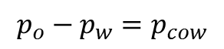
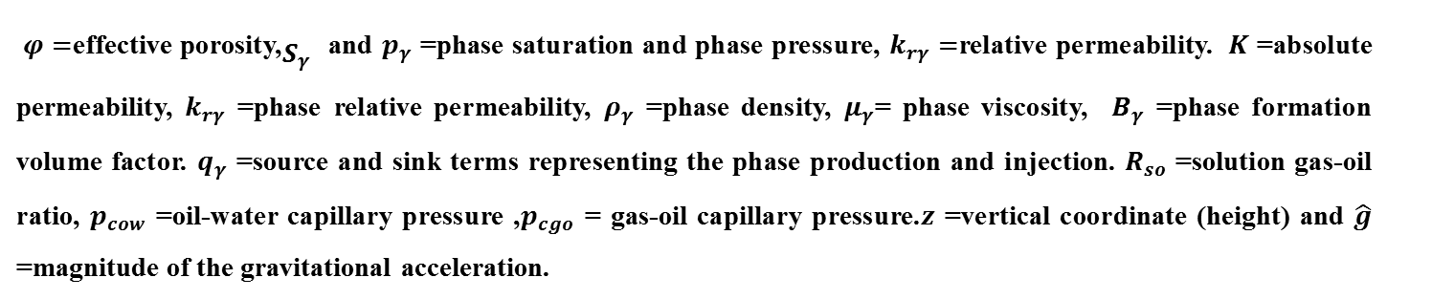
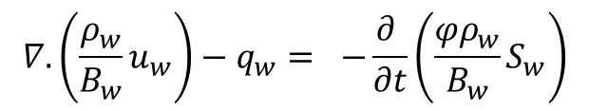
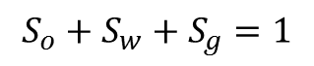
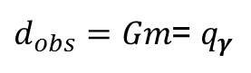
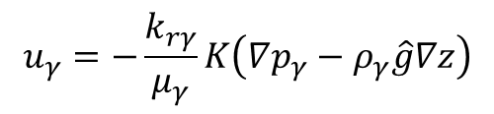
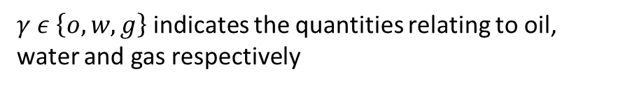
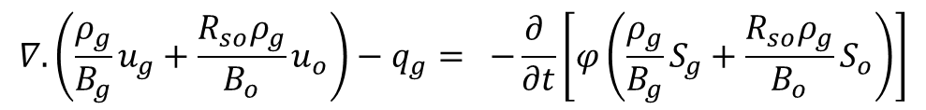
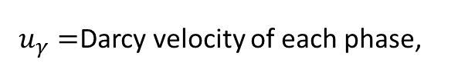
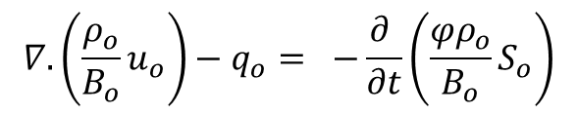
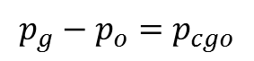
3D Forward Problem. 3 phase fluid flow in porous media
$$∇.\left(\frac{ρ_{w}}{B_{w}}u_{w}\right)−q_{w}= −\frac{∂ }{∂t}\left(\frac{{φρ}_{w}}{B_{w}}S_{w}\right)$$
$$∇.\left(\frac{ρ_{o}}{B_{o}}u_{o}\right)−q_{o}= −\frac{∂ }{∂t}\left(\frac{{φρ}_{o}}{B_{o}}S_{o}\right)$$
,
$$∇.\left(\frac{ρ_{g}}{B_{g}}u_{g}+\frac{R_{so}ρ_{g}}{B_{o}}u_{o}\right)−q_{g}= −\frac{∂ }{∂t}\left[φ\left(\frac{ρ_{g}}{B_{g}}S_{g}+\frac{R_{so}ρ_{g}}{B_{o}}S_{o}\right)\right]$$
$$u_{γ}=−\frac{k_{rγ}}{μ_{γ}}K\left(∇p_{γ}−ρ_{γ}\hat{g}∇z\right)$$
$$S_{o}+S_{w}+S_{g}=1$$
$$p_{o}−p_{w}=p_{cow}$$
$$p_{g}−p_{o}=p_{cgo}$$
$u_{γ}=$Darcy velocity of each phase,
$γ ε \left\{o,w,g\right\}$ indicates the quantities relating to oil, water and gas respectively
$d_{obs}=Gm$= $q_{γ}$
$φ=$effective porosity,${\begin{aligned} \\ S\end{aligned}}_{γ}$ and $p_{γ}$ =phase saturation and phase pressure, $k_{rγ}=$relative permeability. $K$ =absolute permeability, $k_{rγ}$ =phase relative permeability, $ρ_{γ}$ =phase density, $μ_{γ}$= phase viscosity, $B_{γ}$ =phase formation volume factor. $q_{γ}$ =source and sink terms representing the phase production and injection. $R_{so}$ =solution gas-oil ratio, $p_{cow}$ =oil-water capillary pressure ,$p_{cgo}$ = gas-oil capillary pressure.$z$ =vertical coordinate (height) and $\hat{g}$ =magnitude of the gravitational acceleration.
Craft, B. C. & Hawkins, M., 1991. Applied Petroleum Reservoir Engineering. .:Prentice Hall.

Slide 7
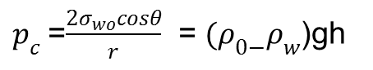
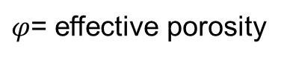
3D Forward Problem. 2 phase fluid flow in porous media
EM(7th year)
MPS or SGS
$$φ\frac{∂S_{𝓁} }{∂t}=∇.\left(κ\frac{k_{r𝓁}}{μ_{𝓁} }\left[∇p_{𝓁}+ρ_{𝓁}ge_{z}\right]\right)+Q_{𝓁}, 𝓁 = w and o(water and oil)$$
MPS or SGS
$φ$= effective porosity
: Saturations
Q =-$\frac{KA}{μ} \frac{dP}{dL}$
Q=$\frac{k_{ro}kA}{μ} \frac{dP}{dL}$
: Pressures
K
: Absolute permeability
$p_{c}$=$\frac{2σ_{wo}cosθ}{r}$ = $(ρ_{0−}ρ_{w}$)gh
: Production Rates (DATA)
$Sw+So$=1
Crichlow, H. B., 1977. MODERN RESERVOIR ENGINEERING-A Simulation Approach. 1st ed. Oklahoma: Prentice-Hall, Inc. Englewood Cliffs, New Jersey 07632

Slide 8
Forward problem, Maxwell Equation
Conductivity Estimation
E: Electric field
H: Magnetic field
: Conductivity
J: Electric Current
: Permittivity
M: Magnetic current
Finite difference Frequency domain
: Permeability
O Dorn, H Bertete-Aguirre and G C Papanicolaou,2007, Adjoint fields and sensitivities for 3D electromagnetic
imaging in isotropic and anisotropic media,, in: Lecture notes in Mathematics, Vol 1943/2008 ‘Inverse Problems
and Imaging’, pp 35-65, Springer Berlin/Heidelberg

Slide 9
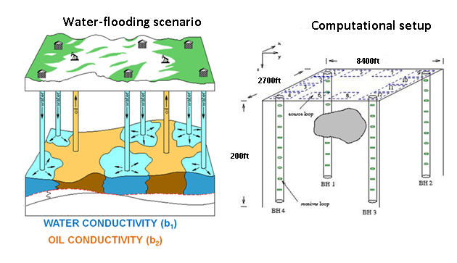
Forward problem Reservoir monitoring from low frequency Electromagnetic (EM) Data. 1KHz
Condutivity Estimation

Slide 10
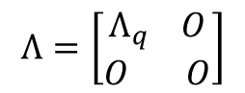
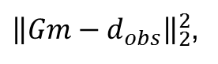
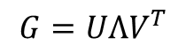
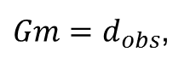
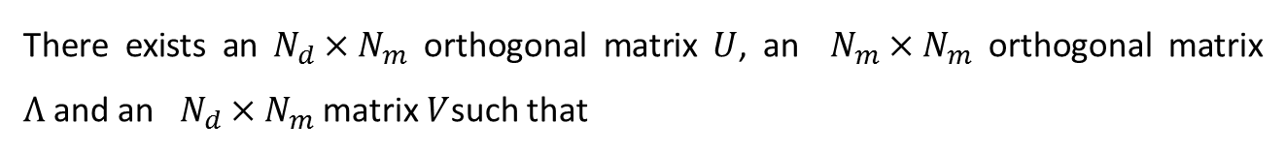
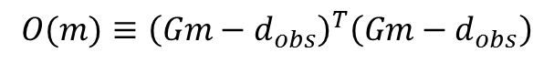
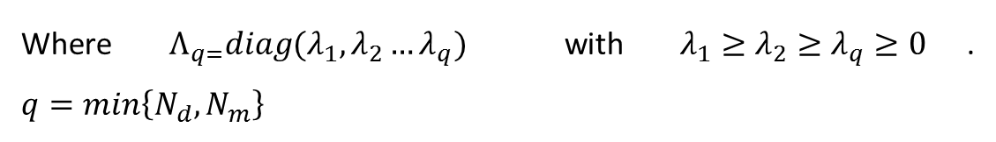
Inverse Problem: History matching
Goal:
$Gm=d_{obs}$,
Simulated
Observed
${\left\|Gm−d_{obs}\right\|}_{2}^{2}$,
$$O(m)≡{\left(Gm−d_{obs}\right)}^{T}\left(Gm−d_{obs}\right)$$
$$G^{T}Gm=G^{T}d_{obs}$$
min
There exists an $N_{d}×N_{m}$ orthogonal matrix $U$, an $N_{m}×N_{m}$ orthogonal matrix $Λ$and an $N_{d}×N_{m}$ matrix $V$such that
$$G=UΛV^{T}$$
$$Λ=\left[\begin{aligned}Λ_{q} O \\ O O\end{aligned}\right]$$
Where $Λ_{q=}diag(λ_{1}, λ_{2}…λ_{q})$ with $λ_{1}≥λ_{2}≥λ_{q}≥0$. $q=min\left\{N_{d},N_{m}\right\}$
$$m_{est}=V\left[\begin{aligned}{Λ_{q}}^{−1} O \\ O O\end{aligned}\right]U^{T}d_{obs}=V_{r}{Λ_{r}}^{−1}U_{r}^{T}d_{obs}$$

Slide 11
Ensemble Kalman Filter
Sequential statistical Monte Carlo method (Derived from Kalman Filter)
Representation of error statistics by an ensemble of model states
Mean and covariance
Evolution of error statistics by ensemble integrations
Stochastic model equation
Bayesian style sequential data assimilation( time-dependent)
Assimilation of measurements using a variance minimizing update
Sequential updating of both model state and static parameters
Model state and parameters converge towards true values
Information accumulates and uncertainty is reduced at each update
Evensen G, et al 2007. Using the EnKF for assisted history matching of a north sea reservoir model. SPE Reservoir simulation symposium, Volume 1, pp. SPE 89942-PA.

Slide 12
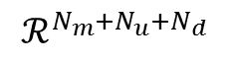
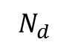
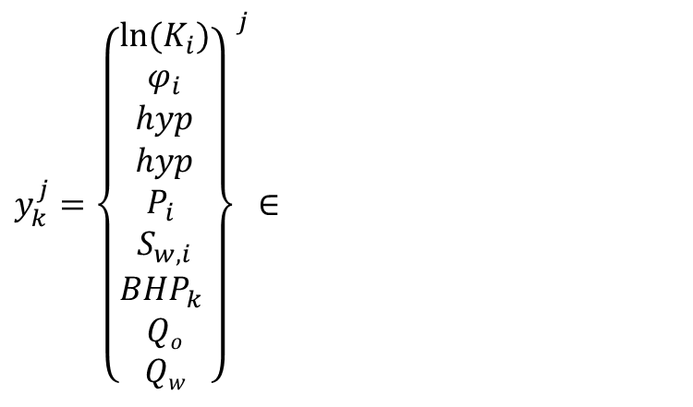
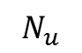
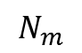
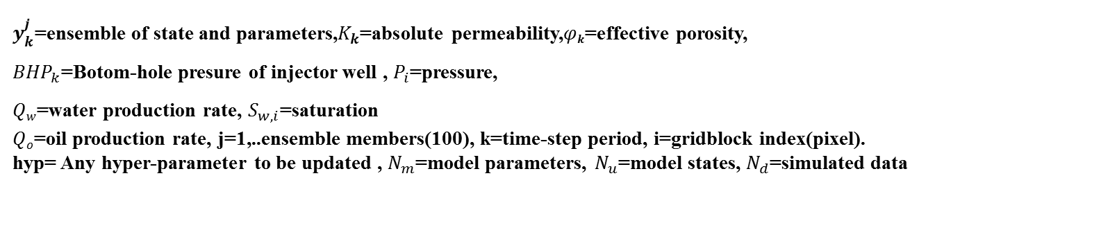
EnKF state-space parameter (model states)
Ensemble Kalman Filter
$y_{k}^{j}={\left\{\begin{aligned}{ln⁡(K}_{i}) \\ φ_{i} \\ hyp \\ hyp \\ P_{i} \\ S_{w,i} \\ {BHP}_{k} \\ Qo \\ Qw\end{aligned}\right\}}^{j}$ $∈$
$$N_{m}$$
$$N_{u}$$
$$ℛ^{N_{m}+N_{u}+N_{d}}$$
$$N_{d}$$
$y_{k}^{j}$=ensemble of state and parameters,$K_{k}$=absolute permeability,$φ_{k}$=effective porosity,
${BHP}_{k}$=Botom-hole presure of injector well , $P_{i}$=pressure,
$Qw$=water production rate, $S_{w,i}$=saturation
$Qo$=oil production rate, j=1,..ensemble members(100), k=time-step period, i=gridblock index(pixel).
hyp= Any hyper-parameter to be updated , $N_{m}$=model parameters, $N_{u}$=model states, $N_{d}$=simulated data

Slide 13
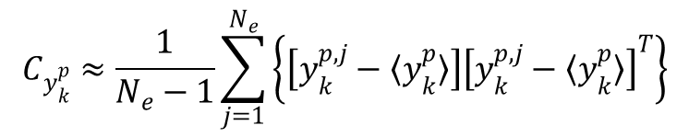
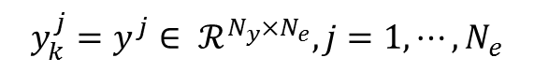

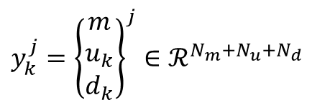
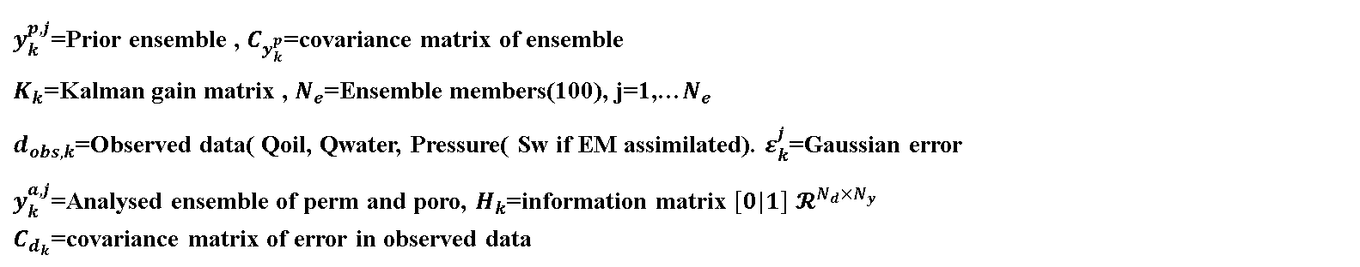
Ensemble Kalman Filter data assimilation (real-time inversion)
Ensemble Kalman Filter
$$y_{k}^{j}={\left\{\begin{aligned}m \\ u_{k} \\ d_{k}\end{aligned}\right\}}^{j}∈ℛ^{N_{m}+N_{u}+N_{d}}$$
$$y_{k}^{j}=y^{j}∈ ℛ^{N_{y}×N_{e}}, j=1,⋯,N_{e}$$
$$y_{k}^{p,j}=F\left(y_{k−1}^{a,j}\right), j=1,⋯,N_{e}$$
$$y_{k}^{a,j}=y_{k}^{p,j}+K_{k}\left(d_{obs,k}+ε_{k}^{j}−H_{k}y_{k}^{p,j}\right),$$
$$j=1,⋯,N_{e}$$
$$C_{y_{k}^{p}}≈\frac{1}{N_{e}−1}\sum_{j=1}^{N_{e}}{\left\{\left[y_{k}^{p,j}−〈y_{k}^{p}〉\right]{\left[y_{k}^{p,j}−〈y_{k}^{p}〉\right]}^{T}\right\}}$$
$$K_{k}=C_{y_{k}^{p}}H_{k}^{T}{\left(H_{k}C_{y_{k}^{p}}H_{k}^{T}+C_{d_{k}}\right)}^{−1}$$
$y_{k}^{p,j}$=Prior ensemble , $C_{y_{k}^{p}}$=covariance matrix of ensemble
$K_{k}$=Kalman gain matrix , $N_{e}$=Ensemble members(100), j=1,…$N_{e}$
$d_{obs,k}$=Observed data( Qoil, Qwater, Pressure( Sw if EM assimilated). $ε_{k}^{j}$=Gaussian error
$y_{k}^{a,j}$=Analysed ensemble of perm and poro, $H_{k}$=information matrix $[0|1]$ $𝓡^{N_{d}×N_{y}}$
$C_{d_{k}}$=covariance matrix of error in observed data

Slide 14
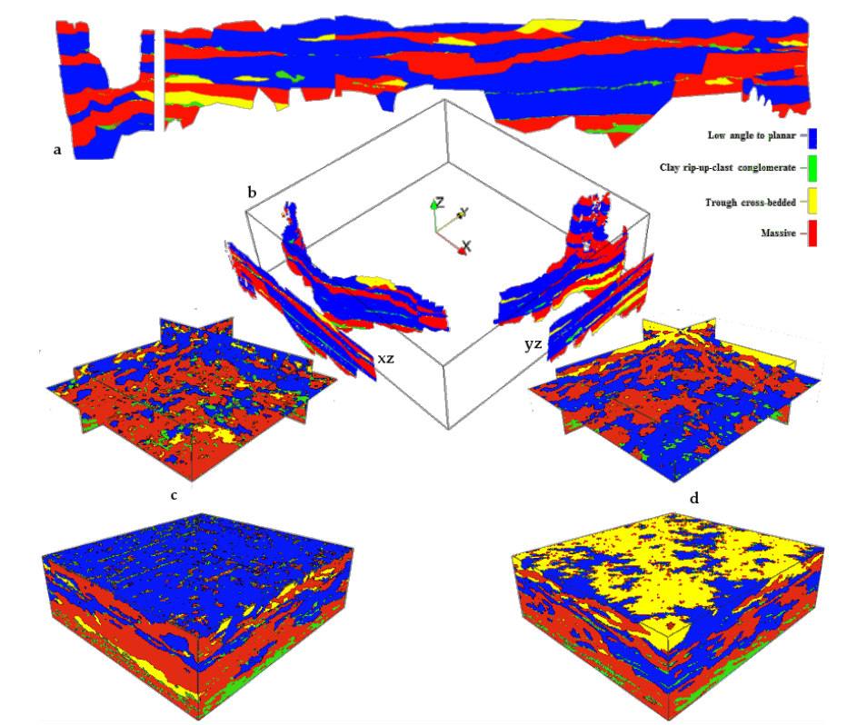
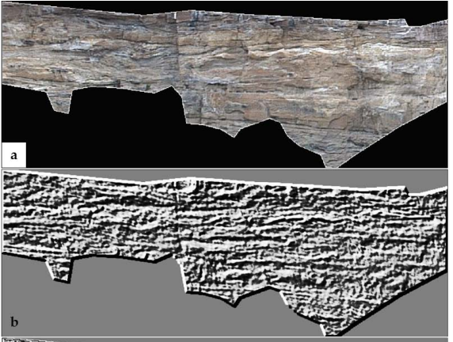

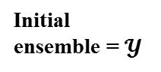
Lidar and Digital Outcrop Modelling(DOM) to get TI’s
$$φ\left(x\right)>0$$
$$φ\left(x\right)<0$$
Lidar: A laser-based measurement system that captures an outcrop geometry
in 3 dimensions (point cloud)
DOM: A spatially constrained, 3D digital MAP of an outcrop built by projecting digital
imagery onto a lidar point cloud derived mesh
Burton, D., D.B. Dunlap, L.J. Wood, & P.P. Flaig, 2011, Lidar intensity as a remote sensor of rock properties, Journal of Sedimentary Research, v. 81, n. 5, p. 339- 347. DOI: 10.2110/jsr.2011.31.

Slide 15
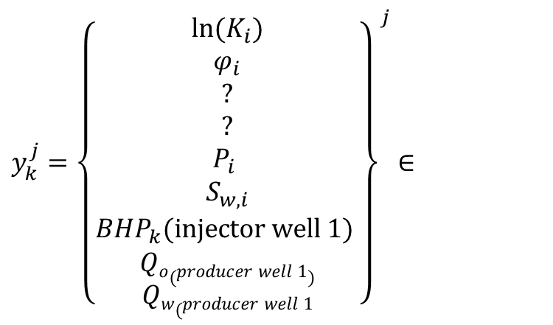
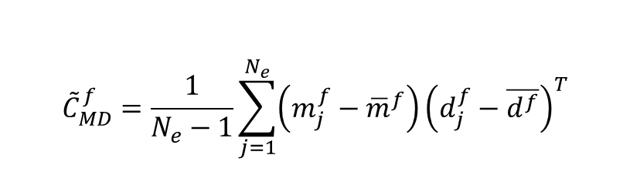
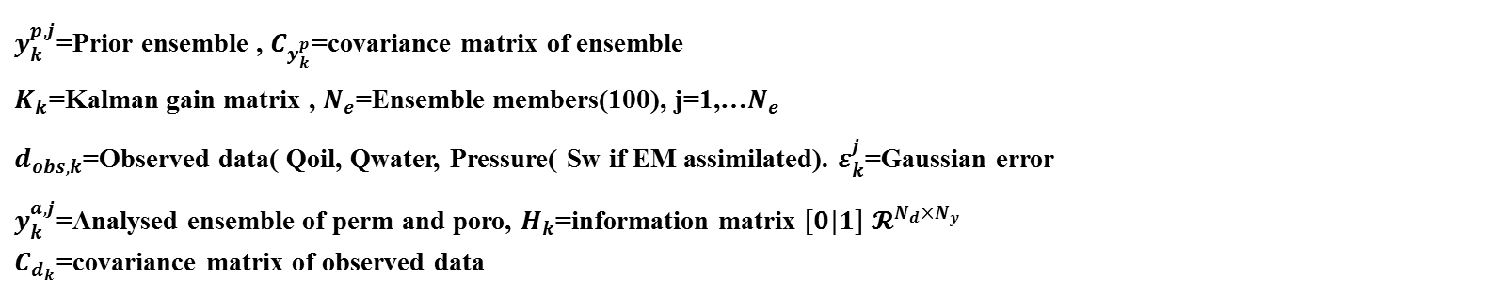
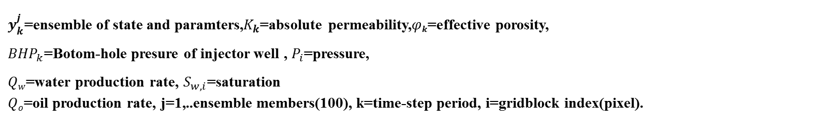
Bayesian Formulation Framework for Uncertainty Quantification
$$posterior pdf∝ Likelihood function pdf×Prior pdf$$
$$Q (m)= \frac{1}{2}(m−m_{pr })T{C_{M}}_{}^{−1}\left(m−m_{pr }\right)+\frac{1}{2}(d_{true}−G{(m}_{pr}))T{C_{D}}_{}^{−1}(d_{true}−G(m_{pr}))$$
$$\overline{m}=m_{pr}+C_{M}G^{T}{\left(GC_{M}G^{T}+C_{D}\right)}^{−1}\left(d_{obs}−G{(m}_{pr})\right)$$
$$m=\left\{\begin{aligned}m_{static properties} \\ G(m)(simulated data)\end{aligned}\right\}$$
$$d_{j}^{f}−\overline{d^{f}}=g\left(m_{uc,j}\right)−g\left({\overline{m}}^{f}\right)=G\left({\overline{m}}^{f}\right)\left(m_{j}^{f}−{\overline{m}}^{f}\right)≡\overline{G}\left(m_{j}^{f}−{\overline{m}}^{f}\right)$$
$${\tilde{C}}_{MD}^{f}=\frac{1}{N_{e}−1}\sum_{j=1}^{N_{e}}{\left(m_{j}^{f}−{\overline{m}}^{f}\right)}{\left(d_{j}^{f}−\overline{d^{f}}\right)}^{T}$$
$$=\frac{1}{N_{e}−1}\sum_{j=1}^{N_{e}}{\left(m_{j}^{f}−{\overline{m}}^{f}\right)}{\left(\overline{G}\left(m_{j}^{f}−{\overline{m}}^{f}\right)\right)}^{T}=C_{M}{\overline{G}}^{T}$$
Tarantola, 2005. Inverse problem theory and methods for model parameter estimation. 1 ed. Philadelphia: SIAM

Slide 16
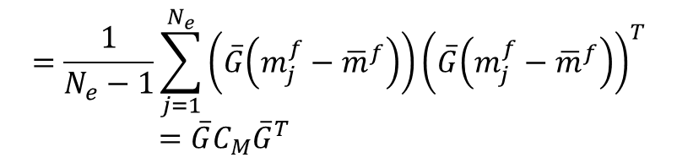
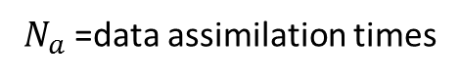
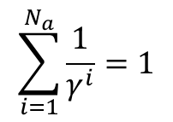

Ensemble Based Optimization Ensemble Smoother Multiple Data Assimilation ES-MDA
$${\tilde{C}}_{DD}^{f}=\frac{1}{N_{e}−1}\sum_{j=1}^{N_{e}}{\left(d_{j}^{f}−\overline{d^{f}}\right)}{\left(d_{j}^{f}−\overline{d^{f}}\right)}^{T}$$
$$=\frac{1}{N_{e}−1}\sum_{j=1}^{N_{e}}{\left(\overline{G}\left(m_{j}^{f}−{\overline{m}}^{f}\right)\right)}{\left(\overline{G}\left(m_{j}^{f}−{\overline{m}}^{f}\right)\right)}^{T}=\overline{G}C_{M}{\overline{G}}^{T}$$
$$m_{j}^{a}=m_{j}^{f}+{\tilde{C}}_{MD}^{f}{\left({\tilde{C}}_{DD}^{f}+γ^{i}C_{D}\right)}^{−1}×\left(d_{uc,j}−d_{j}^{f}\right)$$
$$\sum_{i=1}^{N_{a}}{\frac{1}{γ^{i}}}=1$$
From Bayesian formulation
${\tilde{C}}_{MD}^{f}$ is the estimated covariance between the forecast models and forecast data and${\tilde{C}}_{DD}^{f}$ is the auto covariance of predicted data.
(2013) Ensemble Smoother with Multiple Data Assimilation, Emerick A A., &Reynolds A..:. Computers & Geosciences , 55(11), pp. 3-15
$N_{a}$ =data assimilation times

Slide 17

ES-MDA, Continued
Algorithm : ES-MDA
Choose the number of data assimilations,$N_{a}$ and the coefficients ${ γ}^{i}$ for $i=1,2,…. N_{a}$ For $i=1 to{ N}_{a}$ Run the ensemble from time zero For each ensemble member, perturb the observation vector using $d_{uc,j}=d_{obs}+\sqrt{{ γ}^{i}}{C_{D}}^{\frac{1}{2}}z_{d}$, where $z_{d}\sim 𝒩\left(0,I_{N_{d}}\right)$ Update the ensemble using, $$m_{j}^{a}=m_{j}^{f}+{\tilde{C}}_{MD}^{f}{\left({\tilde{C}}_{DD}^{f}+γ^{i}C_{D}\right)}^{−1}×\left(d_{uc,j}−d_{j}^{f}\right)$$ end(for)
(2013) Ensemble Smoother with Multiple Data Assimilation, Emerick A A., &Reynolds A..:. Computers & Geosciences , 55(11), pp. 3-15

Slide 18
Inverse problem Non-Linear Kaczmarz for EM inversion to conductivity(off-line)
Low Frequency EM inversion
: Conductivity
ADJOINT MAXWELL MODEL
Update term
(Adjoint of Linearised residual operator)
: Complex conjugate of
E_{j}(x): Electric Field

Slide 19
Inverse problem Non-Linear Kaczmarz for EM inversion to conductivity(off-line)
Low Frequency EM inversion
$$b_{p}^{\left(0\right)}=b^{\left(0\right)}$$
Sweep_loop: DO $i=1,I_{max}$
$${ b}_{p}^{\left(i\right)}=b^{\left(i−1\right)}$$
Source_loop: DO $j=1,p$
${δb}_{j}^{\left(i\right)}={−R}_{j}^{′}\left(b_{j−1}^{i}\right)∗ ×R_{j}\left(b_{j−1}^{i}\right)×\hat{C_{j}}$
$b_{j}^{\left(i\right)}=b_{j−1}^{\left(i\right)}+κ_{j}{δb}_{j}^{\left(i\right)}$
END DO source_loop
END DO sweep_loop

Slide 20


Inverse problem. Archie Equation
Water saturation from conductivity
$$\log\left(σ\right)=\log\left(σ_{w}\right)+mlog\left(κφ\right)+nlog\left(S_{w}\right)$$
$$σ_{w}={\left[\left(0.0123+\frac{36,475}{{{10c}_{salt}}^{0.995}}\right)\frac{82}{1.8T_{w}+39}\right]}^{−1}$$
$σ_{w}$=scaled water conductivity(Siemens/m) given by IJWC equation , (Report and Dresser, 1982)
$φ$= effective porosity, $S_{w}$= water saturation distribution, $T_{w}$=temperature of injected water in Celsius
$κ$, $m$, $n$= constants specified in Archie(1942), Hils &Milburn(1956), $c_{salt}$= salt concentration in ppm
$σ$= conductivity (Siemens/m)

Slide 21


Gaspari-Cohn 5th order compact support
Covariance Localisation Matrix
$$ρ=\left\{\begin{matrix}−\frac{1}{4}{\left(\frac{\left|z\right|}{c}\right)}^{5}+\frac{1}{2}{\left(\frac{\left|z\right|}{c}\right)}^{4}+\frac{5}{8}{\left(\frac{\left|z\right|}{c}\right)}^{3}−\frac{5}{3}{\left(\frac{\left|z\right|}{c}\right)}^{2}+1, & 0≤\left|z\right|≤c, \\ \frac{1}{12}{\left(\frac{\left|z\right|}{c}\right)}^{5}−\frac{1}{2}{\left(\frac{\left|z\right|}{c}\right)}^{4}+\frac{5}{8}{\left(\frac{\left|z\right|}{c}\right)}^{3}+\frac{5}{3}{\left(\frac{\left|z\right|}{c}\right)}^{2}−5\left(\frac{\left|z\right|}{c}\right)+4−\frac{2}{3}\left(\frac{\left|z\right|}{c}\right), & c≤\left|z\right|≤2c, \\ 0, & 2c≤\left|z\right|.\end{matrix}\right.$$
$ρ$= correlation matrix, z=Euclidean distance to well location, c=correlation length
Update Equation becomes,
$$y_{k}^{a,j}=y_{k}^{f,j}+ρ o\left(C_{y_{k}^{p}}H_{k}^{T}{\left(H_{k}C_{y_{k}^{p}}H_{k}^{T}+C_{d_{k}}\right)}^{−1}×\left(d_{obs,k}+ε_{k}^{j}−H_{k}y_{k}^{f,j}\right)\right)$$
Acting on the permeability and porosity pixel update

Slide 22
Sparse Representation of Model Space
Reduce computational complexity and enforce prior information by representing the model by a sparse over-complete dictionary learned from the channelized initial ensemble
Combine K-SVD and Orthogonal Matching Pursuit (OMP) for reducing the dimension of the model space (regularization)
K-SVD is an unsupervised learning algorithm to create an over-complete dictionary.
OMP is a greedy algorithm for obtaining a sparse representation of the model parameters X using this over-complete dictionary.
(2006) An Algorithm for Designing Overcomplete Dictionaries for Sparse Representation K-SVD, Aharon M., Elad M. & Bruckstein A..:. IEEE Transactions on Signal Processing, 54(11), pp. 4311-4322.

Slide 23


Compressed sensing K-SVD/OMP
Step 1: K means clustering to select atoms (D)
Dictionary creation $(𝓓$)
Step 2: freeze D and update X with OMP
Step 3: freeze X and update D with K_SVD
[nkcluster_realizations
: nkcluster_realizations]
[ncells : n_ini_realizations]
[ncells : nkcluster_realizations]
t
Y
D
X
=
Initial ensemble geostatistic
Target: Dictionary
From K-SVD
Target: Sparse signal from OMP
$$\left\{X,D\right\}=\underset{X,D}{\arg{min}}\sum_{i=1}^{N_{y }}{{\left\|Y_{i}−DX_{i}\right\|}_{2}^{2}+γ{\left\|X_{i}\right\|}_{1 }}$$

Slide 24

Compressed Sensing, Continued K-SVD
Initialize Dictionary
Replace unused atom with minimally represented signal
Identify signals that use k-th atom (non zero entries in rows of X)
Deselect k-th atom from dictionary
Find coding error matrix of these signals
Minimize this error matrix with rank-1 approximation from SVD
[U,S,V] = svd(E_{k})
Replace coefficient of atom d_{k} in X with entries of s₁v₁
d_{k} = u₁/$||$u₁$||$₂
Sparse Coding
(OMP)
Update Dictionary
One atom at a time

Slide 25
Compressed Sensing, Continued Orthogonal Matching Pursuit(OMP)
D, Y
Select d_{k} with max
projection on residue
x_{k} = arg min ||Y-D_{k}x_{k}||
x
Check terminating
condition
Update residue
r = Y - D_{k}x_{k}

Slide 26


K-SVD with OMP
For a set of training signals $Yi$ , find the elements which are necessary to construct a dictionary $D$ from K-SVD.
Find a sparse combination of elements of D representing each vector of the training set of signals$Yi$
The corresponding weights of the signals describing $Yi$ are denoted as $Xi$ . They are calculated by solving the optimisation problem,
$$\left\{X,D\right\}=\underset{X,D}{\arg{min}}\sum_{i=1}^{N_{y }}{{\left\|Y_{i}−DX_{i}\right\|}_{2}^{2}+γ{\left\|X_{i}\right\|}_{1 }}$$
$${\left\|D_{i}\right\|}_{2}^{2}≤1, ∀i=1,…N_{y }$$
(2006) An Algorithm for Designing Overcomplete Dictionaries for Sparse Representation K-SVD, Aharon M., Elad M. & Bruckstein A..:. IEEE Transactions on Signal Processing, 54(11), pp. 4311-4322.

Slide 27


Root Mean Square Error (RMSE)
Quality measure
Production data misfit
$$RMSE(i)={\left(\frac{1}{N}\sum_{k=1}^{N}{\sum_{j=1}^{N_{data}^{k}}{{\left(\frac{D_{obs}^{j}(k)−D_{sim,i}^{j}(k)}{σ_{n,j}}\right)}^{2}}}\right)}^{\frac{1}{2}}$$
$N$: Number of data assimilation time steps where measurements are assimilated (measurement times)
$N_{data}^{k}$: Number of data collected at each time step $k$
$i$: Ensemble member index
$k$: Time index
$j$: Metric or response (history matched metric or response)
$D_{obs}^{j}\left(k\right)$: Observed data metric for metrics j (Data equivalent in state space ensemble) at time step k.
$D_{sim}^{j}\left(k\right)$: Simulated data from simulator for metrics j (Data equivalent in state space ensemble) at time step
k.
$σ_{n,j}$: Observed data standard deviation for metrics j (Data equivalent in state space ensemble).

Slide 28
History Matching with Level set

Slide 29






Heaviside Function, Narrow-Band Schematic and signed distance transformation
Level Set
$$φ\left(x\right)>0$$
$$φ\left(x\right)<0$$
$$φ\left(x\right)≤0$$
Heaviside representation of K
Equivalent Narrow-band map
Equivalent signed distance representation

Slide 30





Inverse problem. EnKF-Level-set coupling
EnKF- Level Set
Signe distance function
Initial Ensemble state (with Level Set)
$\sqrt{{\left(x_{1}−x_{2}\right)}^{2}+{\left(y_{1}−y_{2}\right)}^{2}+{\left(z_{1}−z\right)}^{2}}$ =$φ(x)$
Heaviside function ($κ$ and $φ$)
$$y_{k}^{j}={\left\{\begin{aligned}{ln⁡(K}_{i,}) \\ φ_{i,k} \\ {φ\left(K\right)i,}_{k} \\ {φ(φ)i,}_{k} \\ P_{i} \\ S_{w,i} \\ {BHP}_{k} \\ Qo \\ Qw\end{aligned}\right\}}^{j}$$
$$ℋ\left(φ\left(x\right)\right)=\left\{\begin{matrix}1 φ\left(x\right)>0 \\ 0 φ\left(x\right)≤0\end{matrix} ,\right.$$
$$\left({K\left(x\right) \atop φ(x)}\right)=\left({K_{high}ℋ\left(φ\left(x\right)\right)+K_{low}(1−ℋ\left(φ\left(x\right)\right)) \atop φ_{high}ℋ\left(φ\left(x\right)\right)+φ_{low}(1−ℋ\left(φ\left(x\right)\right))}\right)$$
Assimilated Ensemble state
$$y_{k}^{a,j}=y_{k}^{f,j}+K_{kalman−gain(k)}\left(d_{obs,k}+ε_{k}^{j}−H_{k}y_{k}^{f,j}\right)∘fn$$
$fn$=Narrow-band function (matrix of 0’s and 1’s)
EnKF-Issues with Computational time!

Slide 31


Numerical results Result of Level-set implementation
(a) (b) (C) (d) (e) (f)
(a) & (d) True permeability field , (b) Model recovered with EnKF-Level set(c) SSIM map of EnKF-Level set,(e) Model recovered by EnKF, and (f) SSIM map of EnKF

Slide 32
Electromagnetic History
Matching

Slide 33










Electromagnetic History Matching
Well logs
Outcrop
IF EM data is available, include
$$S_{w} from$$
conductivity
Conductivity estimation EM (Maxwell Equation)
Seismic survey
Pressure-Production data
Data to be assimilated
Stochastic Realisations
ELSE
Forecast ensemble
Yes/Stop
EnKF
Assimilation using Level set
Stopping
criterion
Reached?
Objective function
Initial ensemble (100 realizations)
Reservoir Simulator
No

Slide 34



Inverse problem EnKF-Level-set coupling( with EM assimilation) and covariance localization
EnKF- Level Set- EM
$y_{k}^{j}={\left\{\begin{aligned}{ln⁡(K}_{i,}) \\ φ_{i,k} \\ {φ\left(K\right)i,}_{k} \\ {φ(φ)i,}_{k} \\ P_{i} \\ S_{w,i} \\ {BHP}_{k}(injector well 1) \\ Qo(producer well 1) \\ Qw(producer well 1 \\ S_{w,i(EM)}\end{aligned}\right\}}^{j}$ $∈$
$$ℛ^{N_{φ}+N_{φ}+N_{u}+N_{d}}$$
$$y_{k}^{a,j}=y_{k}^{f,j}+\left[\begin{aligned}ρ \\ fn\end{aligned}\right]$$
$$o\left(C_{y_{k}^{p}}H_{k}^{T}{\left(H_{k}C_{y_{k}^{p}}H_{k}^{T}+C_{d_{k}}\right)}^{−1}×\left(d_{obs,k}+ε_{k}^{j}−H_{k}y_{k}^{f,j}\right)\right)$$
$fn$=Narrow-band function acts on the level set functions

Slide 35

Gaussian reservoir synthetic model
Property | Value
Grid configuration | 84$×27×4$
Grid size | 100$×100×50$
Well configuration | 2-spot( Line-spot)
Producers | 1
Injectors | 1
Simulation period | 8 yrs
Reservoir depth | 4000ft
Integrated data | Injectors BHP, producers oil and water rates, water saturation distribution(7th year only)
Injectors constraint | 15,000 to10,000( bbl./day)
Producer constraint (BHP) | Constant 140psi
Ensemble size. Number of realizations | 100
Uncertain parameter to estimate | Permeability, porosity, Sw
Number of integration steps | 16

Slide 36


Reference permeability model for Electromagnetic HM experiment
(a)
(b)
(a) 3D permeability field of the true Gaussian synthetic model showing the two well locations and (b) 2D permeability field of the true Gaussian synthetic model showing the two well locations

Slide 37


Numerical Results Conductivity reconstructed from Low-frequency EM data
(a) (b)
2D-view conductivity plume: (a) True water conductivity distribution of the reference/true reservoir, (b) Reconstructed conductivity profile

Slide 38

Numerical Results Conductivity reconstructed from Low-frequency EM data

Slide 39

Numerical Results Water saturation inferred from conductivity
(a) (b)
(a) Reconstructed conductivity profile, (b) Equivalent water saturation distribution of the reconstructed conductivity profile using Archie’s law.

Slide 40

Covariance Localisation Matrix
(a) (b) (c)
(a) Correlation function from 5th order Gaspari –Cohn matrix, (b) Correlation function (sensitivity functions) from our non-linear Kazsmarz solver and (c) Correlation function arriving from the combination of both approaches

Slide 41


RMS Evolution of EM inversion to Conductivity
(A)-RMS evolution during the conductivity reconstruction of the EM data from the sources to receivers.
(B)-RMS function evolution of the reconstructed conductivity profile.

Slide 42




production-data response

Slide 43









production-data response Cont’d

Slide 44

Numerical Results Water-saturation reconstruction from numerical experiments
(a) (b) (c) (d)
Water saturation reconstruction of the various methods. (a) Initial model water saturation, (b) Water saturation recovered by EnKF (d) Water saturation distribution recovered from EnKF-EM and (d) True model water saturation distribution reconstructed from kazsmarz method

Slide 45

Numerical Results Water-saturation reconstruction from numerical experiments-3D view
3D Water saturation reconstruction of the various methods. (a) Initial model water saturation, (b) Water saturation recovered by EnKF (d) Water saturation distribution recovered from EnKF-EM and (d) True model water saturation distribution reconstructed from kazsmarz method

Slide 46


Numerical Results Permeability reconstruction from numerical experiments
(A) (B) (C) (D)
permeability reconstruction from the various methods. (a) Initial permeability model, (b) permeability recovered by EnKF (c) permeability recovered from EnKF-EM and (d) True model permeability field

Slide 47
Numerical Results RMSE Evolution
Realizations | Initial model | RMS value with EM data assimilation | RMS data without EM data assimilation
45 | 67.34 | 20.24 | 15.31
34 | 52.74 | 10.34 | 7.34
67 | 122.45 | 9.38 | 8.96
85 | 45.22 | 7.45 | 4.43
24 | 36.31 | 6.42 | 1.67

Slide 48
4D Seismic History
Matching

Slide 49
4D Seismic History Matching
Compartmentalized reservoirs require understanding of fault dynamics on reservoir management, performance and overall economics,
Fault Transmissibility Multipliers (FTM) are commonly applied in the representation of faults and their effects on production in reservoir simulation.
An absolute multiplier (FTM) is generally applied, and subsequently altered on a trial and error basis, with geological input when available. [Manzocchi et al., 2002].
The acquisition of extensive petrophysical hard data (core samples) from faults is impractical and the traditional estimation of FTM from petrophysical parameters only provides static and local information.

Slide 50




Multi-Phase Fault Transmissibility Multiplier(FTM)
$${Trans}_{1 2}=\frac{2T_{ABS}}{{{L_{1}}/k}_{1}+{{L_{2}}/k}_{2}}$$
$${T_{p}}^{∗}=\frac{{\left[\frac{L_{1}}{k_{1} k_{rp 1 }}+\frac{t_{f}}{k_{f}}+\frac{L_{2}}{k_{2} k_{rp 2 }}\right]}^{−1}}{\frac{2k k_{rp }}{L_{1}+L_{2}} }$$
k_{1,2 :} grid-block permeability
L_{1,2 :} grid-block length
t_{f} : fault thickness
${Trans}_{1 2}$ is the absolute transmissibility multiplier applied in order to represent the effect of fault rock between grid-blocks.
$Trans$ is the absolute transmissibility multiplier in each cell.
${T_{p}}^{∗}$= 2-phase transmissibility multiplier(updated from 4D seismic)
(Manzocchi, et al., 2002)

Slide 51





Previous Work
4D Seismic Data
Fault Analysis
Generate initial ensemble of
FTM values to be used in EnKF loop
Sw inversion
$$∆I=f(∆S_{w})$$
Sw i
Macbeth, et al., 2006
Gassmann., 1951
Pseudo rel. perm curves
In this work FTM are estimated trough quantitative integration of time-lapse data using EnKF.
Mahmood, I. & Villegas, R., 2016. History Matching of Reservoirs by Updating Fault Properties and Rock-fluid Properties Using 4D Seismic Results. Conference Proceeding. EAGE, 78 International Conference & Exhibition, Vienna

Slide 52

Previous Work
Determine 2-phase FTM value
The first step was to make the simulator treat the reservoir zone, and the fault zone as separate distinct regions.
Assign separate relative permeability properties for the fault zone based on data from literature on fault core analysis. Synthetic capillary pressure curves based on literature data following Ringrose’s relation and assigned to the fault
Zone grid-blocks.
Mahmood, I. & Villegas, R., 2016. History Matching of Reservoirs by Updating Fault Properties and Rock-fluid Properties Using 4D Seismic Results. Conference Proceeding. EAGE, 78 International Conference & Exhibition, Vienna

Slide 53

Previous Work
Determine 2-phase FTM value
Reservoir zone and Fault zone grid-blocks assigned as separate regions in simulation
Fault zone grid-blocks assigned separate relative permeability properties based on laboratory core analysis results (Knipe et al. 1997, Al-Hinai et al. 2006)
Synthetic Pc curves generated
Sw from seismic used to create pseudo-relative permeability curves and two-phase FTM
Mahmood, I. & Villegas, R., 2016. History Matching of Reservoirs by Updating Fault Properties and Rock-fluid Properties Using 4D Seismic Results. Conference Proceeding. EAGE, 78 International Conference & Exhibition, Vienna

Slide 54
Objectives
Given the time-lapse impedance maps and Sw (water saturation) inversion outputs
For the initial Deterministic case determine the 2-phase Fault transmissibility multiplier from prior work
Generate an ensemble of permeability and porosity fields using the sequential Gaussian simulation (SGS)
Generate an ensemble of FTM values initially estimated with
4D seismic
Without 4D seismic
History matching the simulation model by using the Ensemble Kalman filter and Levenberg Marquadt procedure(deterministic case) to update the absolute permeability, effective porosity and FTM values
Generate synthetic impedance maps using the Gassmann equations to qualitatively compare simulation results to the real model.
Compare production data matches using Root-mean-square Function and Impedance map reconstruction using structural similarity index metric (SSIM)

Slide 55









Workflow
4D Seismic Data
Fault Analysis
Generate initial ensemble of
FTM values to be used in EnKF loop
Sw inversion
$$∆S_{w}=f(∆I)$$
Sw i
Macbeth, et al., 2006
Gassmann., 1951
Pseudo rel. perm curves
Parametrisation of permeability, porosity and FTM
SGS
Yes/Stop
Initial ensemble of FTM values(with and without 4D seismic results)
3D images instead
3D images instead
EnKF
3D images instead
Stopping
criterion
Reached?
Objective Function
No

Slide 56



Simulation Model
y – directional Fault
Compartment 1
Depth (ft)
Compartment 2

Slide 57

Numerical Experiments
Model | 4D-seismic | FTM value | Mode
LM- 2 phase FTM | Yes | 0.0039 | Deterministic
EnKF-no-FTM | No | 0.002 | Stochastic
EnKF-FTM | No | 0.056 | Stochastic
EnKF-2 phase FTM | Yes | 0.0043 | Stochastic
$$φ=0.000134313×K+0.0981797$$
$K=$absolute permeability ensemble
$φ$ = porosity ensemble

Slide 58

Slide 58
Results
FTM
3D Fault model of the EnKF -2 phase FTM scheme

Slide 59

Results
EnKF (without 4D seismic)
True model
EnKF (K, FTM)
EnKF (K only)
(A-E) Permeability for the true model, (F-J) final permeability for the EnKF-FTM model without 4D seismic, and (K-O) final permeability for the 3D EnKF No-FTM with 4D seismic

Slide 60

Results
EnKF vs Gradient method (with 4D seismic)
True model
EnKF (K & FTM4D)
LM (K & FTM4D)
(A-E) Permeability for the true model, (F-J) final permeability for the EnKF-2phase FTM model with 4D seismic, and (K-O) final permeability for the 3D LM-2phase FTM model with 4D seismic

Slide 61



Result
(a) (b) (c)
Comparison between the History matched models of the EnKF-FTM, EnKF-2 phase FTM, EnKF No-FTM and LM-2 phase FTM: (a) oil production rate profile, (b) water production rate profile and (c) injection pressure profile

Slide 62
Results
RMS values
Model | 4D Seismic | RMS value
EnKF-FTM | No | 4.97
EnKF-2 phase FTM | Yes | 2.98
EnKF-No FTM | No | 5.26
LM-2 phase FTM | Yes | 9.64

Slide 63


Results
Synthetic Impedance map
Forward modelling of rock and fluid physics relationships enables the expression of seismic attributes(acoustic impedance), as a function of reservoir properties such as fluid saturation.
Mahmood, I. & Villegas, R., 2016. History Matching of Reservoirs by Updating Fault Properties and Rock-fluid Properties Using 4D Seismic Results. Conference Proceeding. EAGE, 78 International Conference & Exhibition, Vienna

Slide 64





Results
Reconstructed Impedance images
True
EnKF-2 phase-FTM
EnKF-FTM
LM-2 phase-FTM
EnKF-No-FTM

Slide 65
Results
Structural Similarity Index Metric(SSIM)
We use SSIM to compare the EnKF-FTM, EnKF-2 phase FTM, EnKF No-FTM and LM-2 phase FTM final impedance maps of the history matched models. SSIM is an image quality metric that assesses the visual impact of three characteristics of an image: luminance, contrast, and structure ($l$,$c,$ and $s$). A value of 1 describes complete similarity, 0 describes no similarity and a value of $−1$ indicate complete dissimilarity. The overall index mathematically is a multiplicative combination of the three terms. (Wang, et al., 2004)
We derive our SSIM Normalized cost function as,
$SSIM Normalised Cost function =abs\left(1−Average SSIM index value\right)$……(13)
$Overall cost function=\frac{\left(SSIM Normalised Cost Function +RMS function\right)}{2}$…..(14)

Slide 66
Results
Overall cost function comparison
Experimental Model | SSIM | SSIM Normalised Cost Function | RMS Function | Overall Cost Function
EnKF-FTM | 0.7645 | 0.2355 | 4.97 | 2.603
EnKF-2phase FTM | 0.8522 | 0.1478 | 2.98 | 1.5639
EnKF-No FTM | 0.7480 | 0.252 | 5.26 | 2.756
LM 2-phase FTM | 0.8715 | 0.1285 | 9.64 | 4.884

Slide 67
Conclusions
Multi-phase properties of relative fault transmissibility multipliers results in a closer and lower RMS function.
Impedance maps generated for the two-phase FTM’s result in a close visual match to true.
The LM-2phase FTM model(from prior work) produce a good impedance map reconstruction, however this method was inferior to the EnKF scheme in terms of 2-Norm comparison
EnKF yielded a lower RMS function when compared to prior deterministic method
Assimilating more data during the EnKF inversion scheme leads to a reduced RMS function value to the pressure-production historical data
Future work is to apply a sparse history matching modulation using orthogonal matching pursuit with 4D seismic(on-going work )

Slide 68
History Matching with Machine Learning

Slide 69












Workflow: Sparsity-accelerated structural stochastic optimization
Input to geostatistic:
Training image & prior data
Initial learning ensemble = $Y_{i}$
Over-complete K-SVD Dictionary = $𝓓$
Multiple Point Statistic (MPS)
$$\left\{X,D\right\}=\underset{X,D}{\arg{min}}\sum_{i=1}^{N_{y }}{{\left\|Y_{i}−DX_{i}\right\|}_{2}^{2}+γ{\left\|X_{i}\right\|}_{1 }}$$
K-means& K-SVD (Done off-line and once)
Initial ensemble = $𝓨$
Select 100 Realizations
Learned Dictionary used in OMP
Forward Problem
Forecast
OMP algorithm, convert to sparse domain
$$J=f(d_{j}^{f},Dobs)$$
$${\min_{𝓧}\left\|𝓧\right\|}_{0}$$
${\tilde{C}}_{MD}^{f}$= cov($𝓧$, $d_{j}^{f})$
Reservoir simulator
${\tilde{C}}_{\left(DD\right)sim}^{f}$=cov($d_{j}^{f}$)
$${\left\|𝓨−𝓓𝓧\right\|}_{2 }<η$$
$C_{D}$=cov(error($Dobs$))
Ensemble Smoother Multiple Data Assimilation (ES-MDA):
Analysed ensemble
ii) Recover spatial analysed ensemble
iii) End iteration if convergence reached
Inverse Problem
ES-MDA
Production data
Sparse Domain, permeability ensemble
Notes:
ncells x n_fin_realizations

Slide 70

Sparsity promoting History Matching
Novel History Matching Technique, Coupling,:
ES-MDA
WITH
K-SVD/OMP Unsupervised Dictionary Learning
$$m_{j}^{a}=m_{j}^{p}+{\tilde{C}}_{MD}^{f}{\left({\tilde{C}}_{DD}^{f}+γ^{i}C_{D}\right)}^{−1}×\left(d_{uc,j}−d_{j}^{f}\right)$$
$$\left\{X,D\right\}=\underset{X,D}{\arg{min}}\sum_{i=1}^{N_{y }}{{\left\|Y_{i}−DX_{i}\right\|}_{2}^{2}+γ{\left\|X_{i}\right\|}_{1 }}$$

Slide 71

Numerical Experiments/Results for Sparse HM
Observed Data
4 producer well :Oil rate, water rate, GOR.
4 Water injector wells : Bottom hole pressure
Initial ensemble
100 Models
Porosity and permeability (36,000 active grid blocks
Data Assimilation with ES-MDA

Slide 72

Numerical Experiments/Results for Sparse HM Over-Complete Learned Dictionary from K-SVD
Layers 1-5
………out of 1500
Four selected members of the dictionary

Slide 73


Numerical Experiments/Results for Sparse HM Permeability Reconstruction
Visual comparison. Layers 1-5
ES-MDA & Sparsity
True
Initial ES-MDA

Slide 74
Numerical Experiments/Results Permeability Reconstruction
Visual comparison. Layer 1
Initial
ES-MDA
ES-MDA & Sparsity
True

Slide 75
Numerical Results for sparse HM RMSE Evolution
Realisations | Initial model | ES-MDA | ES-MDA+K-SVD model
47 | 58.34 | 24.24 | 15.31
31 | 52.74 | 10.34 | 10.34
63 | 122.45 | 9.38 | 8.96
86 | 35.22 | 7.45 | 4.43
23 | 36.31 | 9.42 | 0.32

Slide 76


Numerical Experiments/Results for sparse HM Production data match
Initial ensemble
History matched ensemble. ES-MDA & K-SVD/OMP

Slide 77
Conclusions
ES-MDA can efficiently history match complex reservoir models
General tool for parameter and/or state estimation.
Practically no restrictions on parameter space.
Problem with local minima reduced.
Updated ensemble provides future prediction with uncertainty estimates
History matching with Machine Learning Techniques gave lower RMS data match and reasonable permeability reconstruction
The model space was reduced leading to a better-posed inverse problem

Slide 78
References
(2012) Sparse geologic dictionaries for subsurface flow model calibration: Part 1, Inversion formulation, Khaninezhad, M. M., Jafarpour, B. & Li, L., 2012.. Advances in Water Resources, 39(1), pp. 106-121.
(2008) History matching of petroleum reservoirs using a level set technique, Dorn O & Villegas R, INVERSE PROBLEMS Volume: 24 Issue: 3 Article Number: 035015 Published: JUN 2008.
(2006) An Algorithm for Designing Overcomplete Dictionaries for Sparse Representation K-SVD, Aharon M., Elad M. & Bruckstein A..:. IEEE Transactions on Signal Processing, 54(11), pp. 4311-4322.
(2017) History Matching of Reservoirs by Updating Fault Properties Using 4D Seismic Results and Ensemble Kalman Filter, Etienam C, Intesar M & Villegas R , SPE Europec featured at 79th EAGE Conference and Exhibition, Paris, SPE-185780-MS (22pp.).
(2013) Ensemble Smoother with Multiple Data Assimilation, Emerick A A., &Reynolds A..:. Computers & Geosciences , 55(11), pp. 3-15
(2007) Signal recovery from random measurements via orthogonal matching pursuit. Tropp, J. A. & Gilbert, C. A. Information Theory.,,IEEE Transactions on, 53(12), pp. 4655-4666.
(2016) Integrated Structural Reconstruction and History Matching Using Ensemble Filter and Low-frequency Electromagnetic Data. C. Etienam, R. Villegas & M. Babaei. EAGE conference proceeding. EAGE-SPE Annual Conference & Exhibition, Vienna, Austria, June 2016.

Slide 79
References Con’td
(2017) History Matching of Reservoirs by Updating Fault Properties using 4D Seismic Results and Ensemble Kalman Filter. C. Etienam, I. Mahmood and R. Villegas. SPE paper SPE-185780-MS. 79th EAGE-SPE Annual Conference & Exhibition, France, 12-15 June 2017.
(2018) CO2 Sequestration Using Ensemble Kalman Filter and Considering a Sustainability Approach. R. Villegas, C. Etienam, F. Rahma. SPE paper SPE-185780-MS. 80th EAGE-SPE Annual Conference & Exhibition, Copenhagen, 11-14 June 2018.
(2018) Shape and Distributed Parameter Estimation for History Matching using a Modified Ensemble Kalman Filter and Level Sets. ; R. Villegas , C. Etienam, O. Dorn and M Babaei . Submitted to Inverse problems.
(2018) An Enhanced Water-Flooding History Matching Scheme Incorporating Electromagnetics:, C. Etienam, R. Villegas , M. Babaei and O. Dorn, SIAM ,Erlangen, Germany
(2018) An Improved Reservoir Model Calibration using Sparsity and Stochastic Optimization. C. Etienam, R. Villegas , and O. Dorn. ECMI, Budapest, Hungary.
(2009) The Ensemble Kalman Filter in Reservoir Engineering--a Review . S. Aanonsen, , D. Oliver ,A. Reynolds, & B. Vall, . SPE Journal, 14(3), pp. 393-412.

Slide 80
References Con’td
(2009) Evensen, G., 2009. Data Assimilation, The Ensemble Kalman filter. 2nd ed. Berlin: Springer.
(1951) Gassmann, F., 1951. Uber die elastizitat poroser medien: Vierteljahrss-chrift der naturforschenden gesellschaft in Zurich.
(1997) Lia, O. et al., 1997. Uncertainties in reservoir production forecasts. AAPG Bulletin, Issue 81, pp. 775-801.
(2006) Macbeth, C., Floricich, M. & Soldo, J., 2006. Going quantitative with 4D seismic analysis. Geophysical Prospecting, Volume 54, pp. 303-317.
(2016) Mahmood, I. & Villegas, R., 2016. History Matching of Reservoirs by Updating Fault Properties and Rock-fluid Properties Using 4D Seismic Results. Conference Proceeding. EAGE, 78 International Conference & Exhibition, Vienna
(2002) Manzocchi, T., Heath, A., Walsh, J. J. & Childs, C., 2002. The representation of two phase fault-rock properties in flow simulation models. Petroleum Geoscience, Volume 8, pp. 119-132.
(1999) Manzocchi, T., Walsh, J., P. Neil & Yielding, G., 1999. Fault transmissibility multipliers for flow simulation models. Petroleum Geoscience, Volume 5, pp. 53-63.
(2009) Villegas, R., Fisher, Q. 2009. Optimizing fluid-rock properties in compartmentalized reservoirs by using 4D Seismic Data. 2nd International Conference on Faults and Top Seals, Montpelier.
(2004) Wang, Z., Bovik, A. C., Sheikh, H. R. & Simoncelli, E. P., 2004. Image quality assessment: from error visibility to structural similarity. Image processing IEEE Transactions, 13(4), pp. 600-612

Slide 81

Acknowledgement
I will like to thank the Niger Delta Development Commission of Nigeria (NDDC) of the Federal Republic of Nigeria for sponsoring my PhD Program

Slide 82
Thank you for your attention
Comments and questions?

